Slide 1
Want to Amaze Your Students?
Show them new worlds without leaving the classroom.

Slide 2
Why Present 3D in PowerPoint?
3D helps foster conceptual understanding and visual and spatial thinking.
3D Models can be viewed from any angle and with animations specific to 3D those same models can be rotated in real time in your presentation.

Slide 3
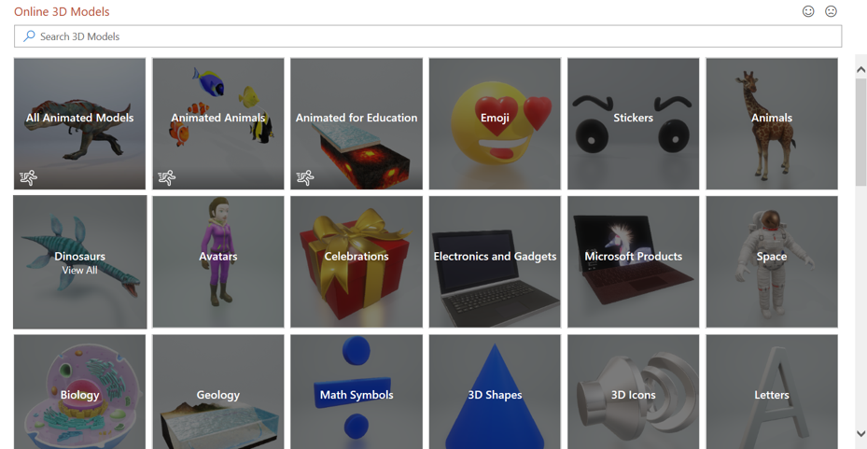
No 3D Model? No Problem!
Online 3D Models
3D Models is a subscription-only feature. If you have an Office subscription, the next slide shows you how it works in a new presentation.

Slide 4
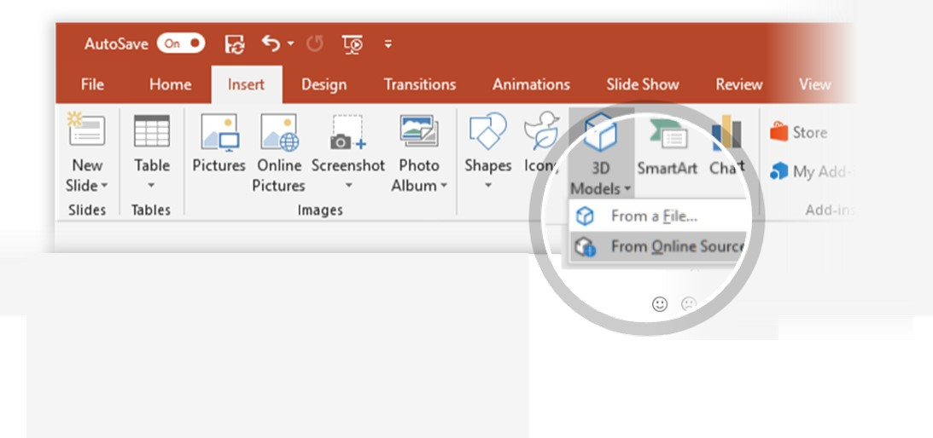
How to Insert a 3D Model
To Insert a 3D Model:
1
From the Ribbon, go to Insert > 3D Models -or-
Insert > 3D Models from Online Sources
That will open the Online 3D Models Window where you can search or browse categories of various 3D models, right from within PowerPoint.
Hint: You need to be online when you add the model.
2
Search by keyword: Type “Triceratops” into the search box at the top of the window and press enter.
3
To insert a 3D Model, click or tap on the model > Insert
The 3D Model will now be downloaded and placed onto your PowerPoint slide.

Slide 5

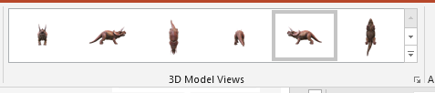
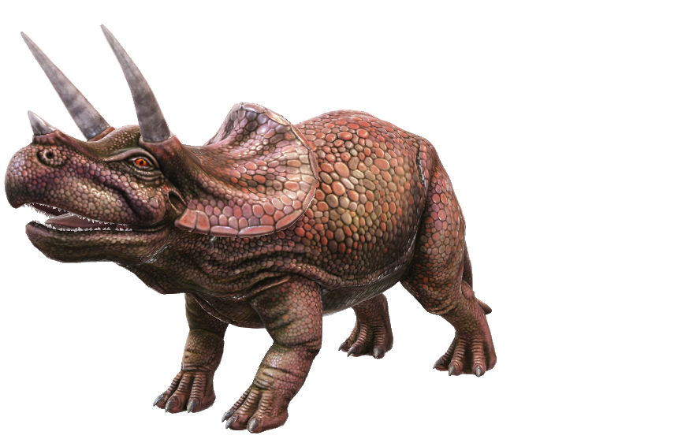
Two Ways to Position and Rotate Your 3D Model
Position & Rotate Model
1
Click or tap to select your 3D Model > Click and hold on the 3D control to rotate or tilt your 3D model up, down, left, and right.
3D Control
Try It: Using the model on the left side of the screen.
2
Alternatively, with your model selected, on the Ribbon, in the 3D Model Tool Format tab, you can click on 3D Model Views gallery to apply one of the various position views.

Slide 6
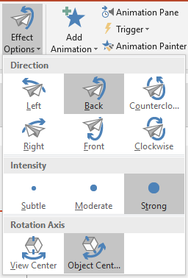
Animate Your Model with New 3D Animations
3D Animations
1
Click or tap on your 3D Model > Animations > Arrive
You should see a preview of the animation play on the slide.
2
Click on the Effect Options button, and change the following settings:
Direction: Back
Intensity: Strong
Rotation Axis: Object Center

Slide 7
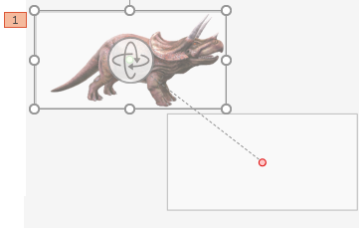
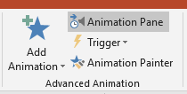
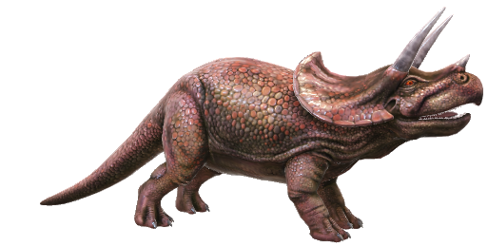
Add Multiple Animations to Make Your Model Come Alive
To add additional animations to your Arrive animation, follow the steps below:
1
2
3
Select your 3D model > Add Animation > Motion Path > Lines
Select your 3D model > Click on the Red End Motion Path Point > Drag the point off the slide
Click on the Animation Pane button > Right-click the Motion Path animation > Select Start with Previous

Slide 8
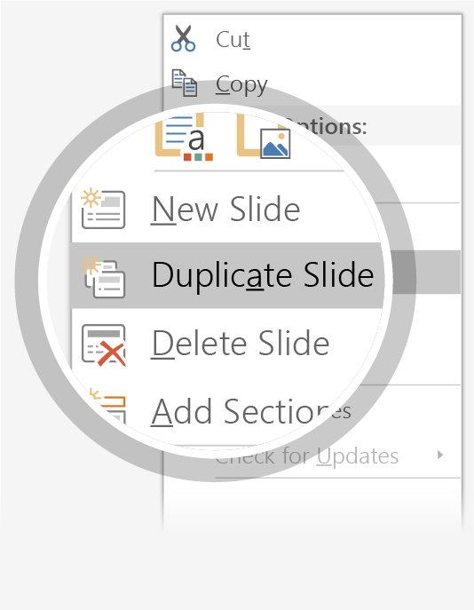
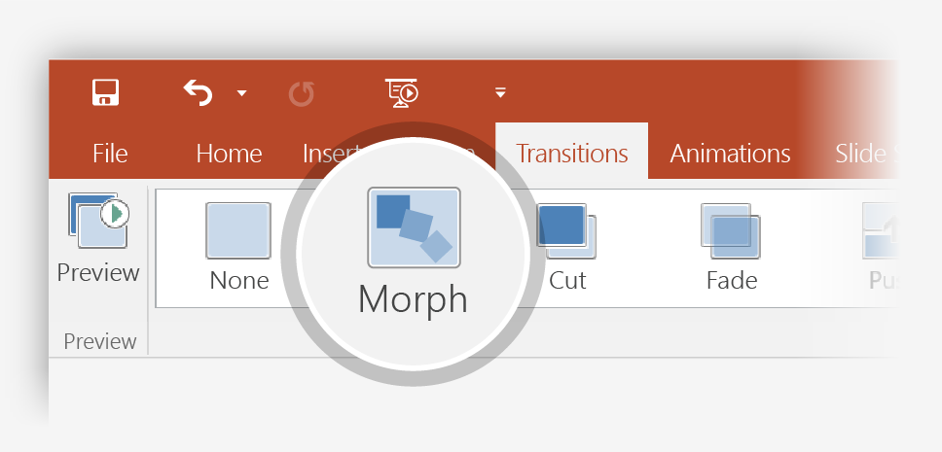
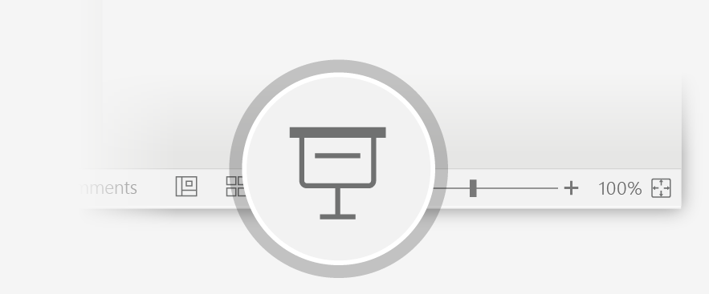
Now Animate Your 3D Model Using the Morph Transition
Try it yourself with the Triceratops on the right:
1
Duplicate this slide: Right-click the slide thumbnail and select Duplicate Slide.
2
In the second of these two identical slides, change the 3D Model on the right in some way (rotate, move, or resize), then go to Transitions > Morph.
3
Return to the first of the two slides and press the Slide Show button and then select Play to see your Triceratops morph!

Slide 9

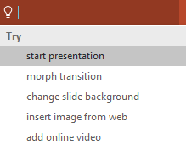

More questions about PowerPoint?
Select the Tell Me button
Select The Arrows When In Slide Show Mode
and type what you want to know.
Visit the PowerPoint team blog
Go to free PowerPoint training

